Slide 1
Introduction to pester
Starting to trust your code

Slide 2
What is a test?
A test is a block of code that:
Allows to validate a given situation / state
Is not something that has to be automatic
Allows to build trust
Basically returns: $True / $False

Slide 3
Testing frameworks
Every language has it's testing framework(s)
Ruby: Rspec,Shoulda,Test::Unit
Java: Junit, Selenium
Csharp: Nunit,Xunit
PowerShell: Pester

Slide 4
Why Test?
Why not?

Slide 5
Quality
Test every (edge) case of a function
Avoid regression (Introducing bugs while adding features)
Ensures the cohesion of a system

Slide 6
TRUSt
You can trust the code to work as expected
Trusting that your last modification didn't break anything
Trust the code that comes from another repo, is bug free (…)

Slide 7
Pester – The code
Syntax + Use cases

Slide 8
Installation
Current latest version: v4.4.2
Shiped in Windows OS :
Windows 10
Windows Server 2016 (v3.3.4)
Install-module Pester
Download latest release from https://github.com/pester/Pester/releases

Slide 9
Demo 1: our first test
Part 1

Slide 10
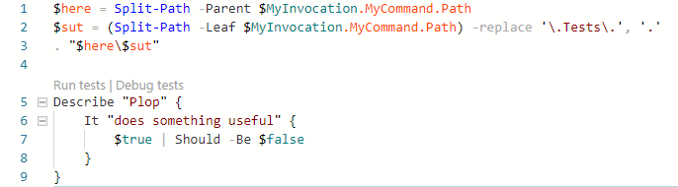
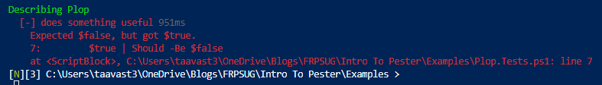
Base test (Using F5)

Slide 11
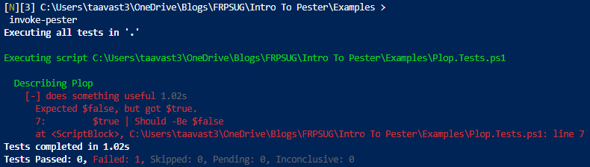
base test (Invoke-Pester)

Slide 12
Base keywords
Describe
(Context)
It
Should

Slide 13
Demo2: Syntax explained
Part 2

Slide 14
Assertions
Should
Be
Not Be
BeExactly
Exist
https://github.com/pester/Pester/wiki/Should

Slide 15
Demo 3
Exercice 1

Slide 16
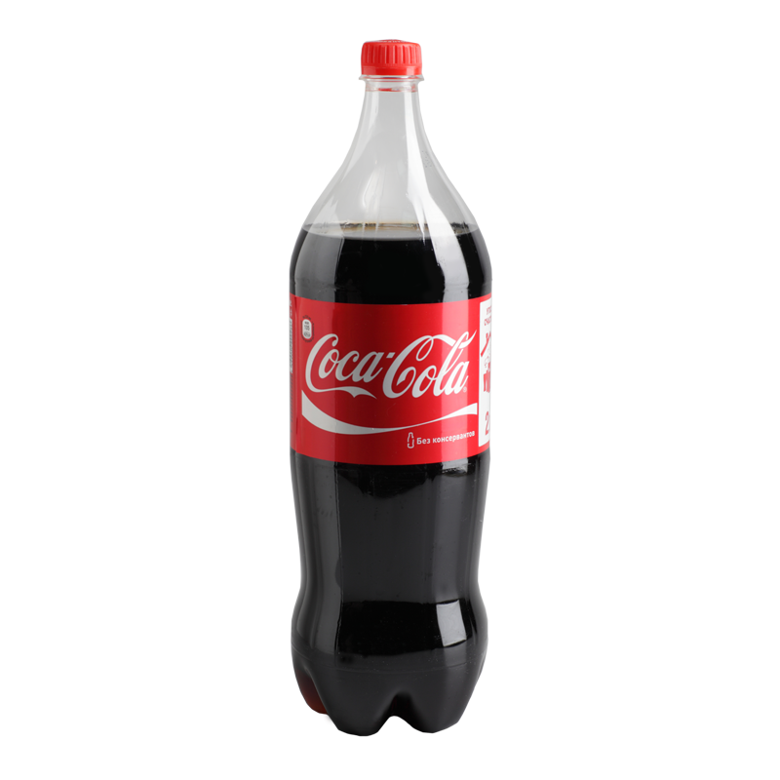
Pair programming: Coca Cola Style (!!)

Slide 17
Coca cola
Coca
Cola
#Create a test for a function called: Export-BiosData that exports BIOS information In the following formats:
#CSV -> $Home\BiosData.csv
#JSON -> $Home\BiosData.Json
#the file must be located at: $Home\BiosData.Json or $Home\BiosData.csv
#Create a function that export Bios data to either:
#CSV File -> $Home\BiosData.csv
#or
#Json File -> $Home\BiosData.Json

Slide 18
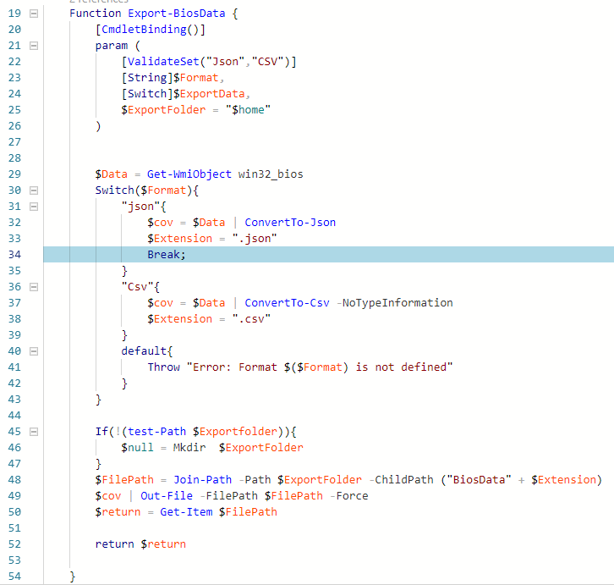
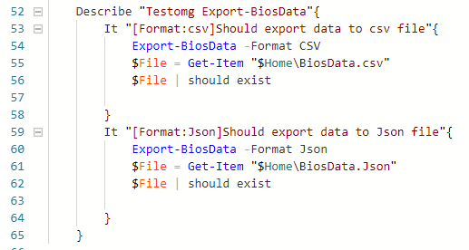
(One possible) Solution
COCA
COLA

Slide 19
Discussion

Slide 20
Advanced Pester concepts
TestDrive

Slide 21
Demo 4: Test drive
Part 4

Slide 22

Pair programming: Tom & Jerry style(!!)

Slide 23
Tom & Jerry
Tom
Jerry
Write a test that:
When parameter –ExportFolder $Path is called, it should export the JSON / CSV data to that $Path folder
File should not pollute user's machine
Hint: Use a test drive
Add parameter –ExportFolder to Export-BiosData
Parameter should accept a string
Cannot be null

Slide 24
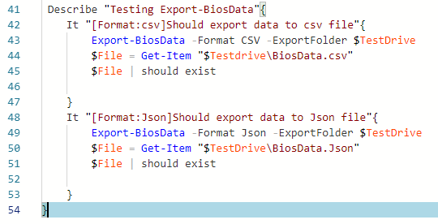
(one possible) solution
tom
Jerry

Slide 25
Demo 5: Test drive applied

Slide 26
Testdrive takeaways
Variable $Testdrive
Drive TestDrive:
Scope -> Describe blocks

Slide 27
Caffe?
Une pause bien Méritée ;)

Slide 28
Advanced Pester concepts
Mocking

Slide 29
Discussion
What is mocking?

Slide 30
Demo 6: Mocking
Part 6

Slide 31
Discussion
Where do you think you could use mocks?

Slide 32
Advanced Pester concepts
Passthru

Slide 33
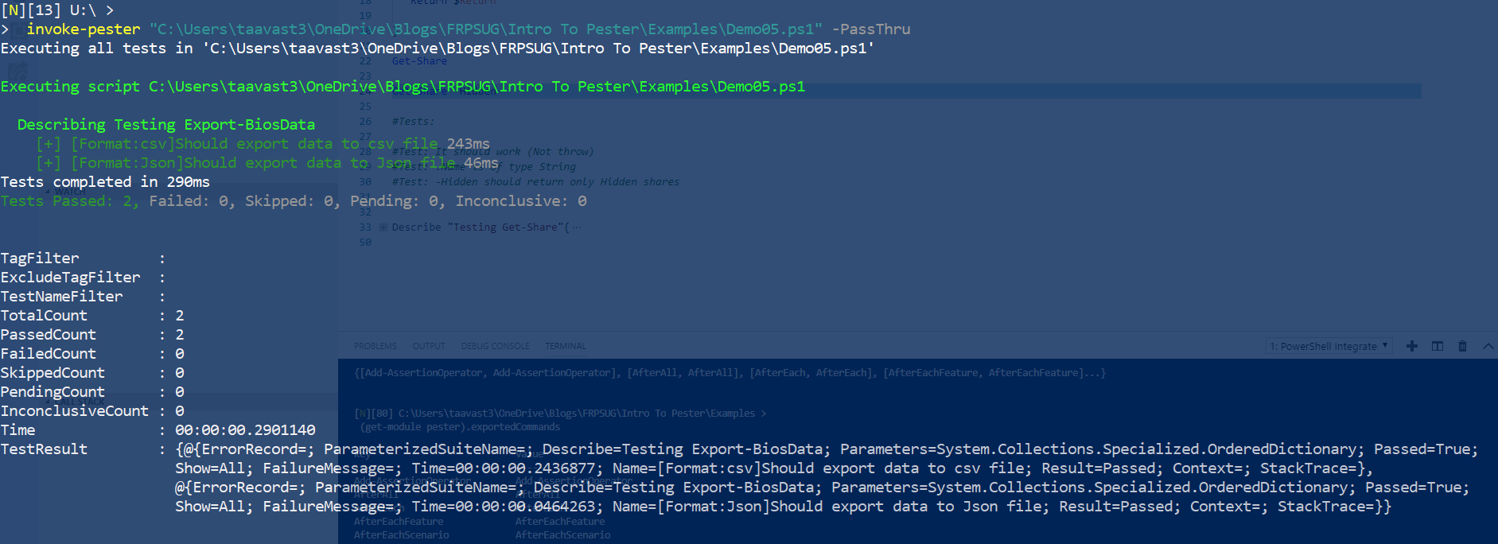
Returning objects

Slide 34
Demo 7: Passthru
Part 7

Slide 35
Discussion
Where do you think you could use Passthru?

Slide 36
Advanced Pester concepts
Passthru

Slide 37
Demo 8: Show
Part 8

Slide 38
Discussion
Where do you think you could use Passthru?

Slide 39
Advanced Pester concepts: exporting Tests
NunitXML

Slide 40
NunitXML
Exporting Tests results to NunitXML allow to persists tests results over time.
NunitXML is a standard Test format
It can be read by most standard CI platforms (Jenkins, Appveyor,Travis,Azure Devops, Gitlab(?))

Slide 41
Demo 9: Nunit
Part 9

Slide 42
Discussion
What do exporting test to nunitxml file allows?
What are the drawback with working with Nunit XML files?

Slide 43
Advanced Pester concepts: POSHNunitXML
NunitXML

Slide 44
POSHNUNINTXML
https://github.com/Stephanevg/PoshNunitXML
Open Source Module I wrote to convert NunitXML back into an usable object
Is class based
Requires Powershell version 5.1

Slide 45
Honorable mentions
InModuleScope
BeforeEach
AfterEach
TestCases
Tag

